Slide 1
Patterns of Effective Test Setup
@spetryjohnson
seth@petry-johnson.com
Notes:
Welcome to “Patterns of Effective Test Setup”.
Show of hands:
Any sort of experience with automated testing?
Ever struggled to set up a test?
Ever skipped a test because it was hard to write?

Slide 2
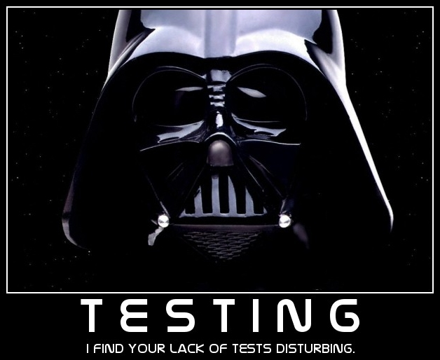
Notes:
You’re in the right place.
Automated testing is very important part of software development
something that people struggle with.
I really hate seeing devs skip tests that could be valuable, and I’d like to help you stop doing that.

Slide 3

Obligatory “About Me”
@spetryjohnson
www.petry-johnson.com
Notes:
It’s customary to begin a talk like this by explaining who I am and why I’m qualified to stand up here and talk about it
Main qualification = writing tests for 9 years, and every day I try to write them better than before.
Philosophy is that tests are incredibly important, but doing them wrong is bad. Too important to get wrong.
When I started current job 5 YEARS ago, frustrated at how frequently team would skip tests b/c too hard or too costly to write
Not a dig at coworkers – we work on large, data-driven applications that are hard to test
Devs wanted to write tests
Devs knew how to write the assertion…
… didn’t know how to get to the point where they could make that assertion.
In other words, didn’t know how to set up the test
Share techniques developed as response to that frustration

Slide 4
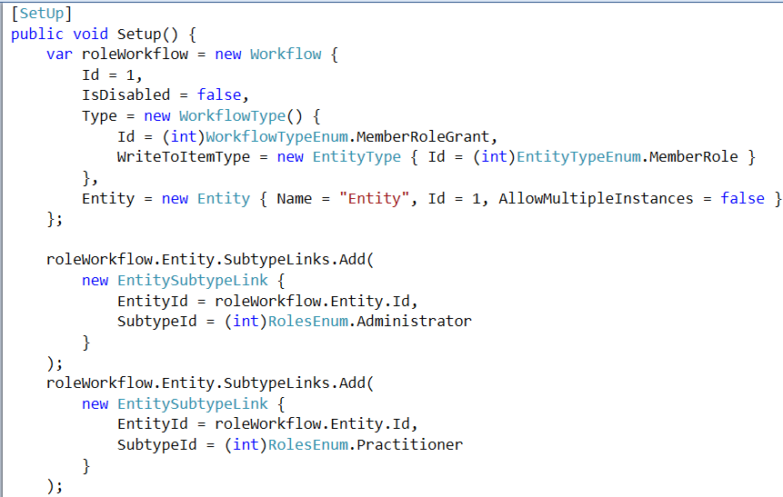
Behold, the reason we’re here
Notes:
Minute ago said I hated seeing people SKIP tests because they would be hard to write
That’s only half the reason I wrote this talk – other half is seeing really convoluted setup code in the tests that DO get written
Here’s an example – needed to make minor adjustment to a feature
Feature itself was complex, but the new change was simple – should not take a lot of time
Before writing any new code, wanted to learn more about how the feature currently worked and wanted to write a failing test
CLICK: So I opened up the file containing the existing tests, and my heart sank when I saw this: <PAUSE>

Slide 5
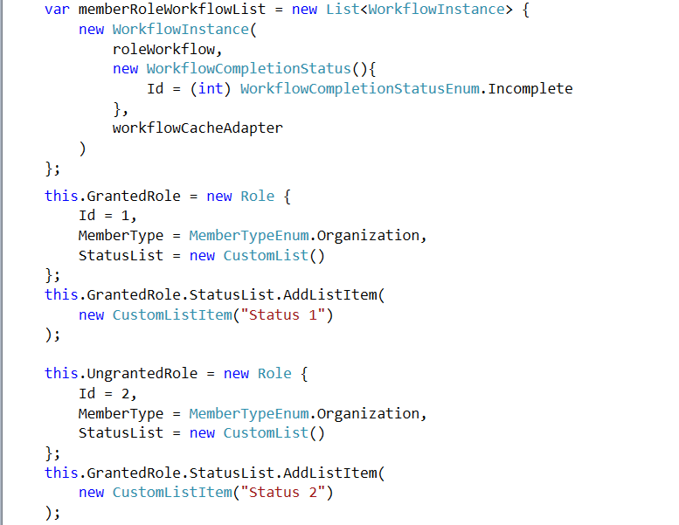
Notes:
... And this …

Slide 6
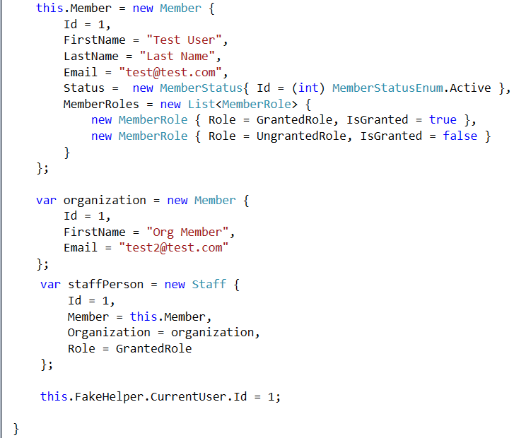
Notes:
… and this.

Slide 7
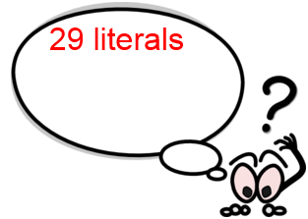
Notes:
That’s 29 string, integer and Boolean values being initialized….

Slide 8
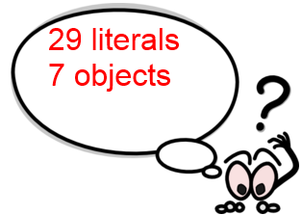
Notes:
… 7 objects being created…

Slide 9
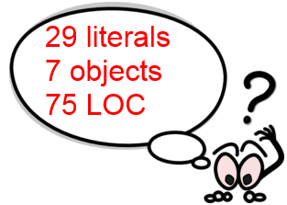
Notes:
… and 75 lines of code to understand.

Slide 10
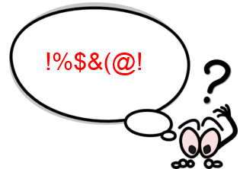
Notes:
This is just the SHARED setup code for the test suite. Individual tests had more code like this, and all depended on different portions of this mess.
Became clear that even though my change was simple, understanding and modifying tests would not be
Went back to team – increased estimate – spent more time than should have been necessary
Not an isolated case – thousands of tests in our projects
Countless hours spent reading those tests and trying to make sense of stuff like this
TRANSITION: This sucks. Fortunately, it doesn’t have to be this way.

Slide 11

What’s on the agenda?
Notes:
Goals today:
Help you understand how costly poor setup code can be. First step in recovery is admitting you have a problem!
Show you some basic patterns for reducing those costs
Share some advanced tips and tricks that make a really big difference
NOT going to talk about mocking/stubbing – come back next month!

Slide 12
What “setup” are we talking about, exactly?
Code written outside individual tests ( “fixture” setup)
Notes:
Before we go any further, let’s define a few terms and talk about what “setup” means.
Most test frameworks allow you to share setup code between multiple tests.
Often referred to as “fixture setup”.
“Fixture” refers to the consistent known state that is established prior to running a test
The code I just showed you was an example of fixture setup code

Slide 13
What “setup” are we talking about, exactly?
Code written outside individual tests ( “fixture” setup)
Code written inside individual tests
Notes:
In addition to the shared setup code, each individual test can set up its own test data.

Slide 14
What “setup” are we talking about, exactly?
Code written outside individual tests ( “fixture” setup)
Code written inside individual tests
When I say “setup”, I mean the union of these
Notes:
When I say “setup”, I’m referring to either
“SETUP CODE” = any code you write to arrange your test, regardless of where
“TEST DATA” = any objects that you create within that setup code.

Slide 15

A cautionary tale – the costs of poor setup
Notes:
First step in writing better setup is to be consciously aware of the costs of bad setup code
Big picture is:
When tests are difficult to write, they don’t get written
When tests are difficult to maintain, they don’t justify your investment in them
TRANSITION: Let’s look at some SPECIFIC ways that poor setup code makes tests difficult to write or maintain

Slide 16
A cautionary tale – the costs of poor setup
Complex code ➔ complex setup
Notes:
First, complex code begets complex setup.
Not the most insightful statement, but true
More complicated app ➔ bigger objects ➔ deeper graph ➔ more code
Code == liability
More code ➔ higher cost

Slide 17
A cautionary tale – the costs of poor setup
Complex code ➔ complex setup
Dependencies you don’t care about
Notes:
Often have tests that only care about a PORTION of an object’s data
Order’s SHIPPING STATUS may not care about line items
Customer’s ADDRESS may not care about their name
Not always possible to create objects and specify ONLY what you care about
Constructor
Being forced to think about irrelevant dependencies makes it harder to write new tests
Also harder to MAINTAIN tests
Need to create Customer in order to create Order, and Customer changes, your test may break
We really don’t want tests to break when unrelated parts of the system change

Slide 18
A cautionary tale – the costs of poor setup
Complex code ➔ complex setup
Dependencies you don’t care about
“Noise” values obscure what’s really important
Notes:
Simple properties can be an issue too
Imagine code that fails if the Customer email address is null, or some integer field is left at 0
When setting up tests, we initialize those objects to some non-default value
These values, which DO NOT MATTER to the test, are hard to distinguish from other values that DO MATTER to the test
Other programmers work harder to determine which can be changed without affecting the test
In order for tests to serve as useful documentation:
Have to clearly communicate the conditions under which their assertions hold true
That sort of clear communication is IMPOSSIBLE when relevant and irrelevant data are MIXED together

Slide 19
A cautionary tale – the costs of poor setup
Complex code ➔ complex setup
Dependencies you don’t care about
“Noise” objects obscure what’s really important
Re-use of setup code ➔ restrictive inheritance
Notes:
Lastly, poor setup code can burn you when its incorrectly reused.
When first started, noticed many tests had lot of data in common
Example: Two nearly identical tests for Boolean
Full of youthful naivete, I would push as much data as possible into a base class
Just like with “real” code, inheritance is restrictive way of achieving re-use
Quick and easy and works for simple scenarios
Gets out of hand as tests diverge
Think back to the nasty test I showed
29 string, integer and Boolean objects being initialize
Needed to change one to test the new feature
Had to read all the other tests to tell if it was safe to change
If it wasn’t safe, would have had to hack apart the setup code to allow individual tests to modify

Slide 20
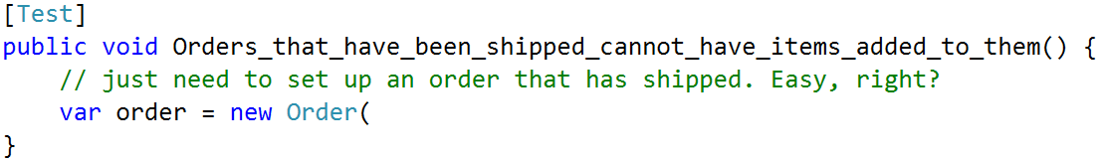
A cautionary tale – the costs of poor setup
Notes:
Here’s an example of what these costs look like in code.
In this test, all I need is a shipped Order.

Slide 21
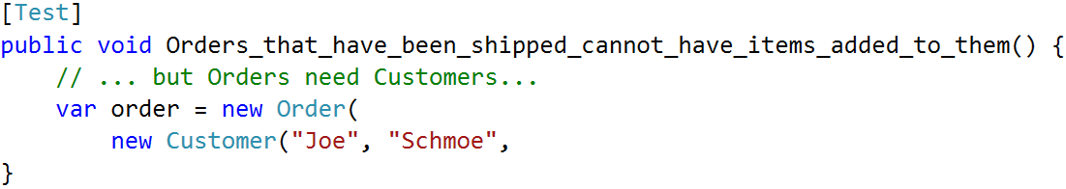
A cautionary tale – the costs of poor setup
Notes:
But apparently an Order object needs a Customer…

Slide 22
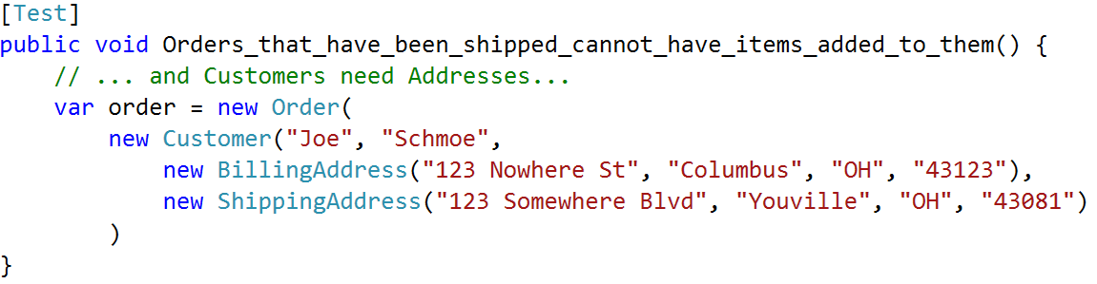
A cautionary tale – the costs of poor setup
Notes:
… and a Customer needs some Addressess…

Slide 23
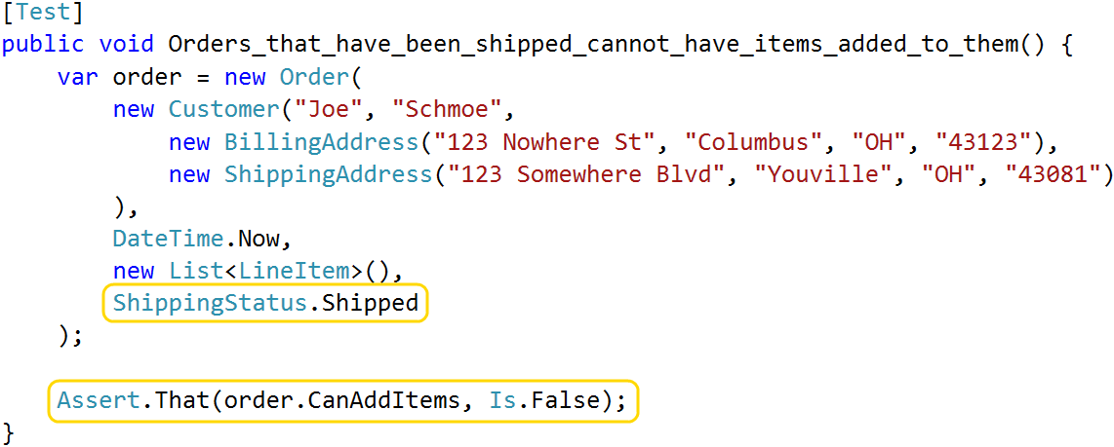
A cautionary tale – the costs of poor setup
Notes:
… and by the time I’ve satisfied the constructor, I’ve written a whole lot of code when I really only care about two things: the order’s shipping status, and whether or not it accepts new items.

Slide 24
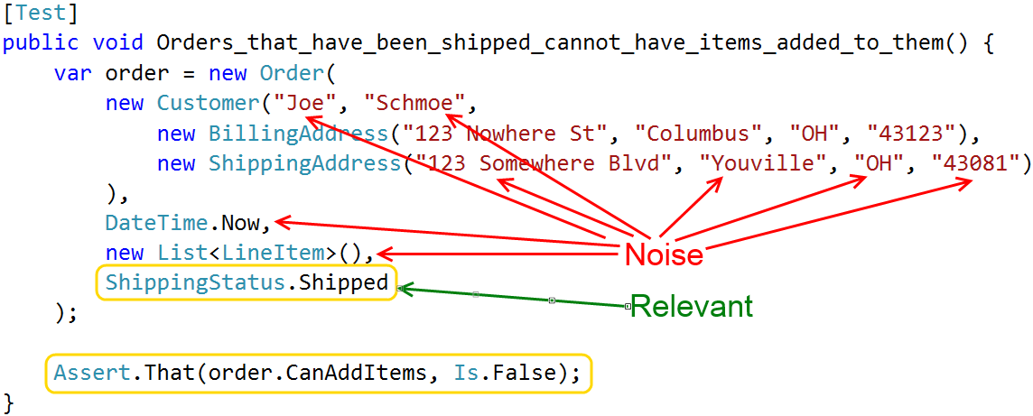
A cautionary tale – the costs of poor setup
Notes:
All the things I created, but don’t care about, are noise
Every time you read this – filter signal through noise
Some objects I deal with have 4, 5 or even 6 layers of composition
Object A uses B, B uses C, etc
Irrelevant dependencies and noise values are a huge problem in large systems like this
TRANSITION: Noise values aren’t just distracting – also liabilities and make tests brittle

Slide 25
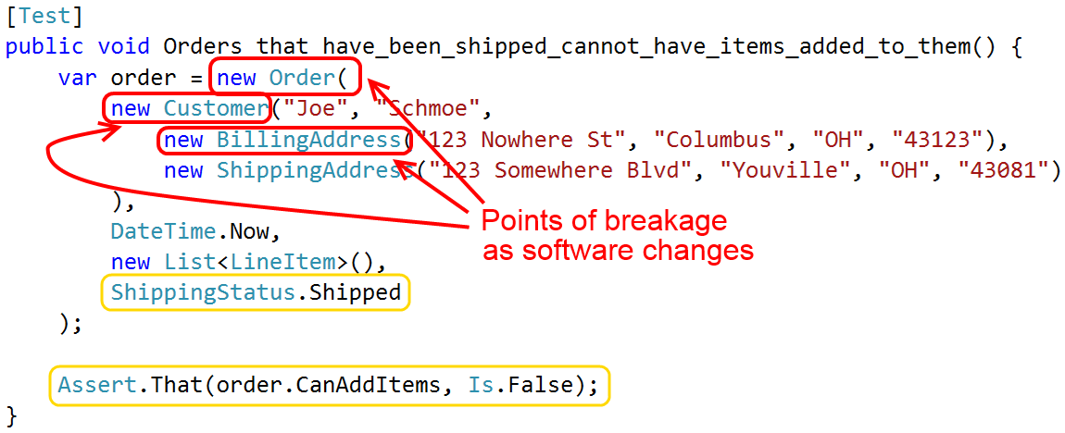
A cautionary tale – the costs of poor setup
Notes:
What happens when the Order, Customer or Address constructors get modified?
If you’ve ever made a simple change to your application, and then spent the next two hours cleaning up failing tests, you’ve felt this pain.

Slide 26
A cautionary tale – the costs of poor setup
Hard to write ➔ aren’t written
Hard to understand ➔ little value
Fragile ➔ drain on velocity
Notes:
To summarize, poor setup code makes test hard to write and maintain.
CLICK: If tests are hard to write, we don’t write them
CLICK: If tests are hard to understand, we get less value from our investment
CLICK: Brittle tests get ignored & train people that broken tests are “OK”

Slide 27

A cautionary tale – the costs of poor setup
Notes:
Tests that break and are hard to change or understand have a tendency to get “fixed” with the delete key.
All that potential value, thrown away.

Slide 28

Ain’t nobody got time for all that!
Notes:
So how do we write tests that don’t suck up all our time, money and energy?
Start by identifying core principles of good setup code
Highly expressive – delve into what that means in a moment
Highlights what really matters
Avoids inheritance for data reuse
Resilient - Doesn’t need constant upkeep as software changes
TRANSITION: Let’s look at those in more detail.

Slide 29
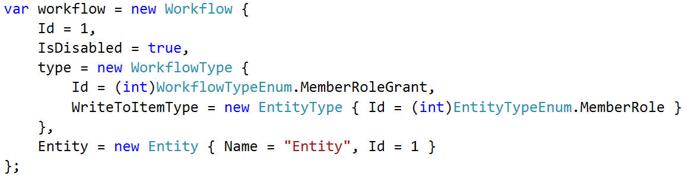
Good setup code is highly expressive
Short & clearly establishes the baseline state
High “signal-to-noise ratio”
Can reader quickly skim the code?
Easily spot differences in similar tests?
Notes:
The first principle is that tests should be “highly expressive”. What does that mean?
Dictionary defines “expressive” as “effectively conveying thought or meaning”
Setup code should clearly convey the scenario that’s being created and why
We can’t understand the assertions unless we understand the context too
Important that readers can come to that understanding quickly
Thousands of tests –read every day - Don’t waste time
Easy to look at similar tests and spot what’s different
CLICK: Here’s an example. Quick, what’s the point of this code?
Hard for me to tell too

Slide 30
Good setup code is highly expressive
Short & clearly establishes the baseline state
High “signal-to-noise ratio”
Can reader quickly skim the code?
Easily spot differences in similar tests?
Notes:
How about this?
Does same thing - removed all the extraneous noise
This is the sort of readability I’m talking about

Slide 31
Good setup code is highly expressive
Entire test should fit on screen at 1 time
Notes:
Another way to write expressive code is to write LESS of it
General rule of thumb - avoid writing tests that require more than 1 screen of code
Purpose of this constraint - hyper-focused on the clarity of my setup code.
If can’t describe the test data in just a few statements - writing that code at too low a level.
Like refactoring a method into smaller and smaller pieces: just keep asking yourself, can I describe this with fewer code?
I’ll show you some techniques in a few minutes that help me meet this goal more often than not.

Slide 32
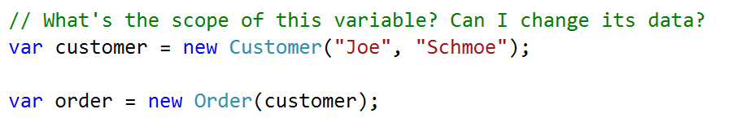
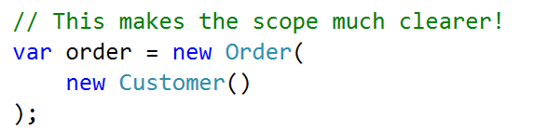
Good setup code is highly expressive
Entire test should fit on screen at 1 time
Avoid intermediate objects
Notes:
Sometimes need to create one object only to create something else.
Example: need a Customer to create an Order
Two statements, one meaningful operation [create the Order]
Not immediately clear if the Customer is reused elsewhere. Is it safe to change?
Is the customer data part of the core essence of the test? Or is it noise?
CLICK: 2nd image:
Moving instantiation of Customer inside the Order constructor - express 1 meaningful operation as 1 code statement.
Avoiding intermediate objects improves clarity

Slide 33

Good setup code is highly expressive
Make clear why you’re doing what you’re doing
Notes:
Making it easier to understand WHAT is only half the battle
Good setup code communicates WHY
Computer doesn’t care about your motivations
Co-workers, and future you, DO care
Don’t make them guess!

Slide 34
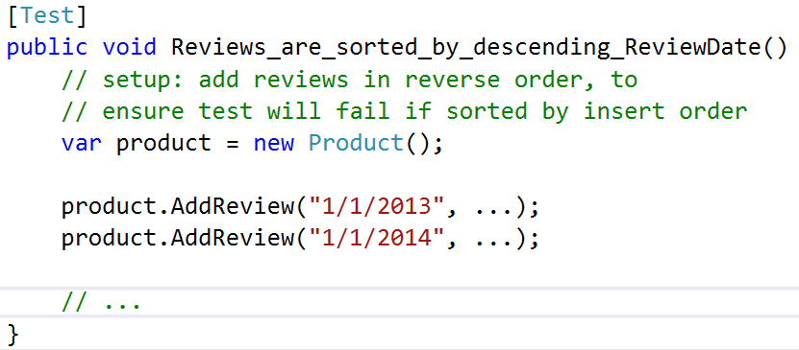
Good setup code is highly expressive
Make clear why you’re doing what you’re doing
Notes:
Example: Test asserts that product reviews are sorted in a specific way
Setup intentionally adds data in reverse order than it should be output
This arrangement is crucial – if we insert data in sorted order, how do we know the sorting code works?
Comment draws attention to this significance
Different rules about comments in test code than production
Production code strives to make comments unnecessary – extract method
Less likely to extract small, one-off methods in test code
Clutters the files
Hard to manage at scale
If setup code needs more than 1- or 2-line comment, extract to helper

Slide 35
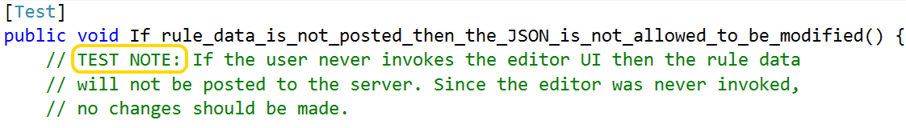
Good setup code is highly expressive
Make clear why you’re doing something
Notes:
Another good use of comments is to explain why a test exists in the first place.
Example from a real project.
Always post JSON string to server
Server should ignore unless other data also present
Test was important, but only because of implementation details
Possible to re-write interface & make this test pointless
No good way to describe that nuance in test name
Adding comment to top of the test adds the necessary context – helpers future coders determine if the test can be removed
Personal convention: “TEST NOTE”
Help me spot features that are too complex
Signal that test name is insufficient, or implementation too complex
Use rarely: out of 1000+ tests, < 30 use this
Do everything you can to make comments unnecessary – but use them well when they are necessary

Slide 36
Good setup code highlights what matters…
Notes:
This next principle is that “good setup code highlights what matters and downplays what doesn’t”.
Goal is to clearly differentiate data that impact the test and data that don’t
Easier for programmers to read and maintain tests

Slide 37
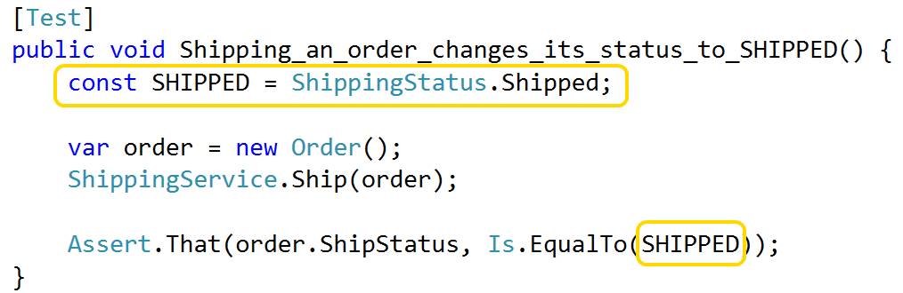
Good setup code highlights what matters…
Named constants for important values
Notes:
Replace key values with named constants
Three benefits:
Draw attention to them and visually reinforces their importance
Makes the code read more like English
Makes it easier to spot differences between otherwise similar tests.
TRANSITION:
In this example, name communicates its value
Even more effective when name communicates its purpose in the test

Slide 38
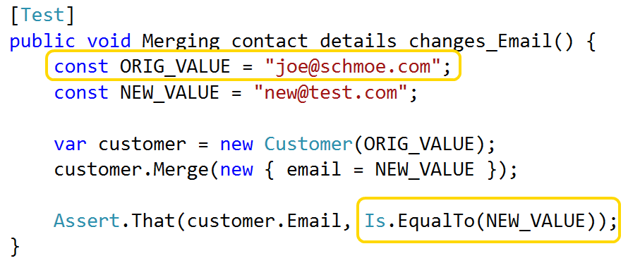
Good setup code highlights what matters…
Named constants for important values
Notes:
In this example, the actual value is irrelevant
Note how the names of “original value” and “new value” give extra clarity to the assertion
Pause
Transition: Of course, giving things good names applies everywhere, not just to constants.

Slide 39
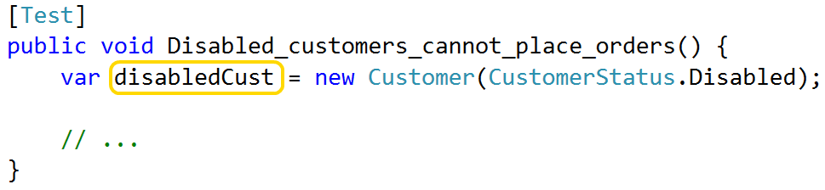
Good setup code highlights what matters…
Give data objects descriptive names
Notes:
Just like in production code, give test objects names that communicate their purpose
If your test revolves around the fact that a Customer is disabled, call it “disabled customer”

Slide 40
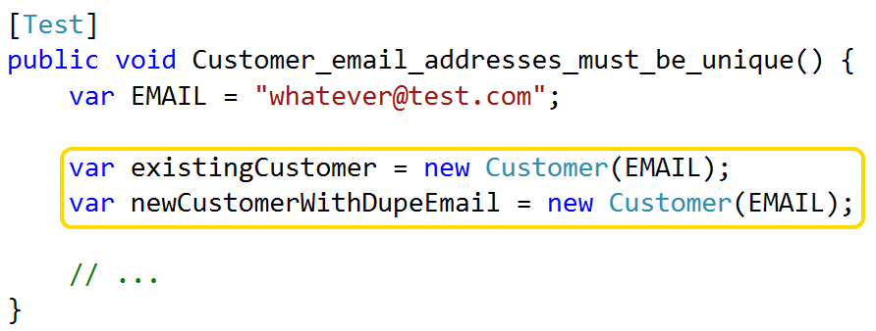
Good setup code highlights what matters…
Give data objects descriptive names
Notes:
If contains multiple objects of same time, use names to differentiate them
Sounds obvious, but if I had a nickel for every time “customer 1” and “customer 2”….
I’d have a lot of nickels.
Tests should tell a story – easier to understand when actors have meaningful names.
Doesn’t take a lot of effort
Makes a big difference
I hate coinage, don’t need any more nickels
Transition:
Important that meaningful data stands out
Also important to downplay data that isn’t as meaningful

Slide 41
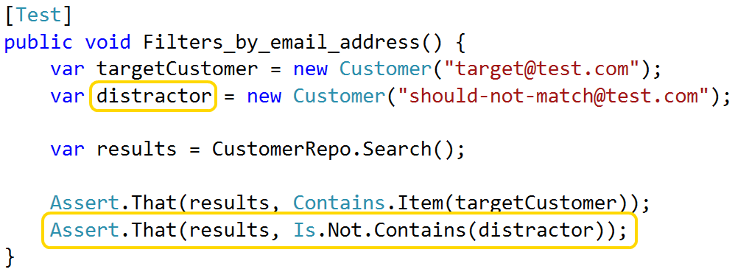
… and downplays what doesn’t
Give data objects descriptive names
Notes:
Common example where this is useful
When writing tests for search or filter, important to do positive AND negative test
Just as important that code returns the things it should as does NOT return what it shouldn’t
My convention is to use the term “distractor” when naming the objects that shouldn’t get returned
Communicates object is not important, as long as its different from the target
Use that name consistently, co-workers immediately recognize the point of these objects
This sort of instant pattern recognition is another key benefit of expressive code

Slide 42
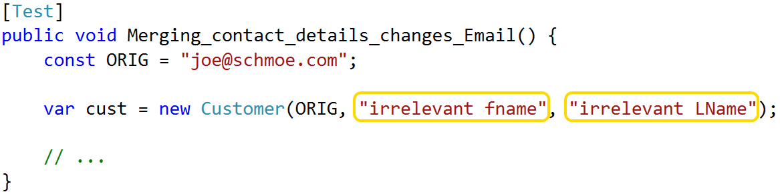
… and downplays what doesn’t
Consistent use of “dummy” values
42, “irrelevant”, etc
Don’t use defaults like null and zero; avoid “unexpected equality”
Notes:
Another way to downplay is w/ consistent dummy values
Example: constructor takes 3 arguments, I only care about 1
Passing null might cause errors
Use value that is obviously irrelevant
Try to avoid numbers like 0, 1, and 2
Frequently appear as meaningful values
Want arbitrary values to stand out – I use “42” as my dummy integer
You can use whatever you want – just be consistent

Slide 43
Good setup code avoids inheritance
Base classes should not construct data
Hard to tweak data for each test
Notes:
The third principle of good setup code is to avoid inheritance, at least for the purposes of creating test data.
CLICK
The first reason is that inheritance makes it hard to tweak shared data for each test
Imagine you have 5 tests covering the same piece of code
Setup for these tests will be very similar
For sake of example, lets’s say that any 2 tests will have 90% of same setup needs
Different tests have different 90% in common
One might need to change an Order’s ship status, another might need to change a Customer’s name
This can be handled w/ inheritance – not clean, not elegant

Slide 44
Good setup code avoids inheritance
Base classes should not construct data
Hard to tweak data for each test
No re-use in other tests
Notes:
Inheritance also limits ability to re-use setup logic.
Assume generic setup, like linked Customer, Order and Line Item.
Useful when testing any of those objects
Don’t want to force inheritance hierarchy
To re-use setup logic, we need to get it out of the base class & into something more easily shared
In a few minutes, I’ll show a clean and elegant technique for doing this without inheritance

Slide 45
Good setup code avoids inheritance
Base classes should not construct data
Hard to tweak data for each test
No re-use in other tests
Base classes can set up infrastructure…
… and initialize shared services
… and stub out behavior orthogonal to the test
… but they should avoid creating data.
Notes:
Base classes can initialize shared services or stub out certain types of behavior
Just avoid creating data

Slide 46
Good setup code is resilient to change
Trivial changes != mountains of errors
Notes:
4th principle of good setup code is that it is resilient to changes in the main app
Tests should be adding value
Not subtracting it by demanding constant attention

Slide 47
Good setup code is resilient to change
Trivial changes != mountains of errors
Minimal effort to refactor tests
Notes:
In the same vein, we want to be able to easily refactor our test projects
Seen people be sloppier in test code than real code – that’s a mistake
Important to keep tests malleable

Slide 48

Patterns & Practices - show me the codez!
Notes:
Just identified 4 principles of good setup code. Next - concrete patterns and practices
CLICK FOR IMAGE
Most important thing to improve setup code – stop constructing test objects by hand
Push into helper for two benefits:
Shorter setup code - easier to write and maintain
Greater resiliency - if an object changes, only modify helper

Slide 49
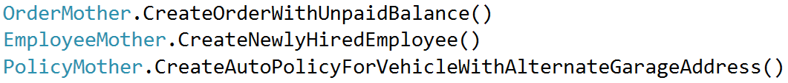
Patterns we tried, but didn’t like
Object Mother
Notes:
We tried a couple existing object creation patterns but had some problems with them
CLICK for Object Mother
First pattern we tried was called Object Mother
Refers to a factory that returns fully-constructed objects in a very specific state
For example, one factory method might return a completed order with an unpaid balance, another might create an insurance policy object with a specific combination of coverages
Object Mother does good of making your tests more expressive, but it doesn’t scale well
As software gets more complex, you need more and more pre-built objects
As the number of pre-built objects grows it becomes harder to maintain them and harder for developers to choose between them

Slide 50
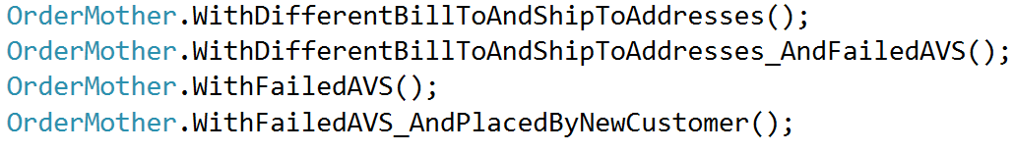
Patterns we tried, but didn’t like
Object Mother
Notes:
Eventually, you end up with a mess like this:
Lots of overlap == lots of duplication
More there are, harder to choose == people keep creating new ones

Slide 51
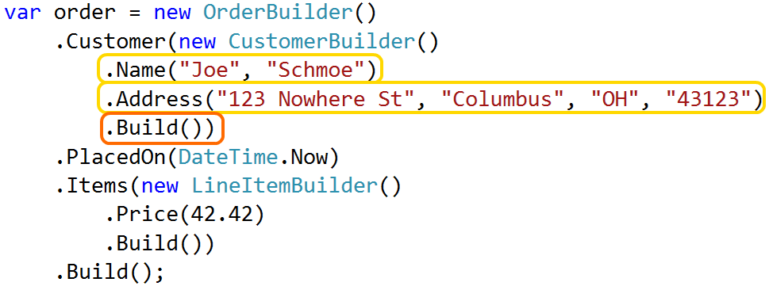
Patterns we tried, but didn’t like
Data Builder
Notes:
The next thing we tried was a pattern called Data Builder.
Rather than pre-built objects, Data Builder lets you create customized objects in the body of each test
Builder uses a Fluent API to expose methods for customizing the object in different ways
You chain these methods together and call Build() at the end, at which point the Builder returns a fully constructed object
I like this approach a lot more than Object Mother because it lets us create the precise data we need for each test. This scales much better.

Slide 52
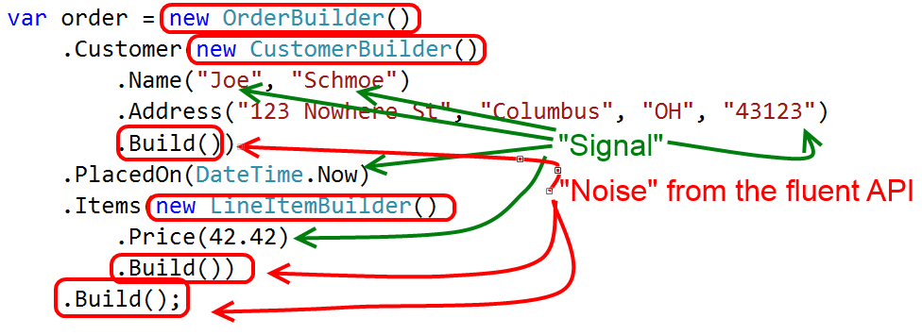
Patterns we tried, but didn’t like
Data Builder
Notes:
However, I’m not a big fan of the fluent API.
It’s verbose and adds a lot of noise, as you see here
Annoying boilerplate code to implement the fluent API

Slide 53
Patterns & Practices – Test Helpers
Like a Builder, without the fluent API
Notes:
Transition: Eventually, we created a hybrid of these two patterns that we call the Test Helper pattern
A “Test Helper” combines the static factory class of Object Mother with the customizable nature of a Data Builder, minus the Fluent API.

Slide 54
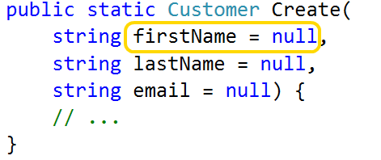
Patterns & Practices – Test Helpers
Like a Builder, without the fluent API
Specify data via named, optional parameters
Notes:
Implemented using a feature of .NET 4.0 called “optional parameters”
First, create a static factory method like an Object Mother
Expose each customizable property as a method param
In most cases, expose all major properties
Remember – don’t want callers to specify irrelevant data
Make params optional by assigning a default value in method signature

Slide 55
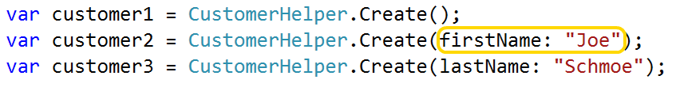
Patterns & Practices – Test Helpers
Like a Builder, without the fluent API
Specify data via named, optional parameters
Notes:
When you call the method, use this “named argument” syntax to pick & choose arguments to specify
Any optional parameter that you don’t provide is assigned its default value
Clean, low-noise API for describing test data in precise detail
Transition:
To get the most value, important to implement correctly
Let’s look at some suggestions

Slide 56
Patterns & Practices – Test Helpers
Assign unique values – avoid “unexpected equality”
Notes:
First, try to avoid creating objects that have properties equal to null or hardcoded values
Null can lead to errors
Hardcoded values can lead to “unexpected equality”
Example: create two Customers from the helper, then compare their email address. Should they be equal?
Too many tests fail that should have passed, or vice versa, because of this unexpected equality
By default, MAKE THINGS UNIQUE – force callers to be explicit if they want things to be equal

Slide 57
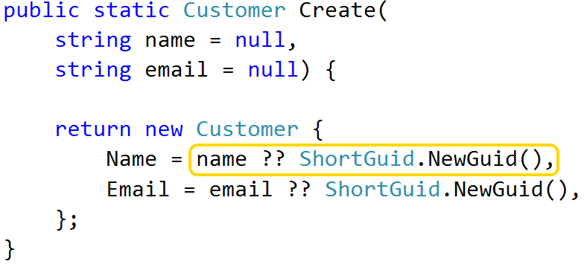
Patterns & Practices – Test Helpers
Assign unique values – avoid “unexpected equality”
ShortGuid for short, unique strings (bit.ly/1dCxSbe)
Notes:
Nice way of creating unique strings is w/ ShortGuid
Compresses a normal GUID into a 22-character string by Base64-encoding it
Result is short, URL-friendly, and unique
In this example, every string property on the Customer will be unique unless caller specifies a value

Slide 58
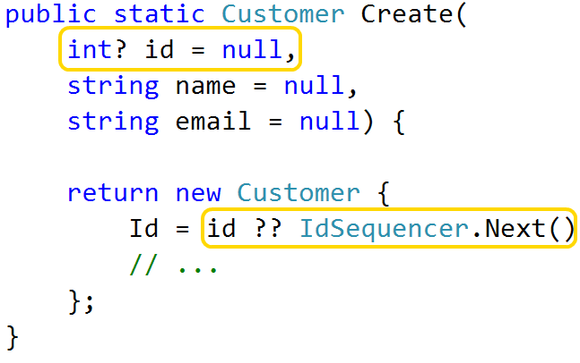
Patterns & Practices – Test Helpers
Assign unique values – avoid “unexpected equality”
ShortGuid for short, unique strings (bit.ly/1dCxSbe)
IdSequencer for unique integers (bit.ly/1d7zHz7)
Notes:
To create unique integers, I use a class I call the IdSequencer
Every time you call Next() it returns a new value
If we have time I’ll show you how it works – or hit the bit.ly link
I always assign unique integers to Id fields – callers can explicitly set up differently if they need to
I may or may not assign unique integers to other fields, it depends on what they are.

Slide 59
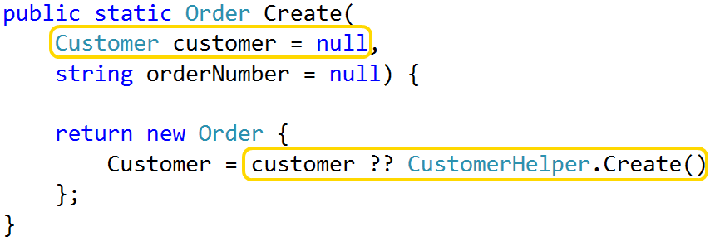
Patterns & Practices – Test Helpers
Delegate to other helpers as needed
Notes:
It’s also important that each Test Helper is concerned with creating a single type of object only
If your object has some sort of dependency, delegate to another helper to create it
Here’s an example of an Order Helper that allows its Customer to be passed as a parameter
If the caller doesn’t pass a Customer, it calls the CustomerHelper
This way we end up with a fully-specified object, and each helper stays focused on one thing only
This is really important and will help keep your maintenance costs in check

Slide 60
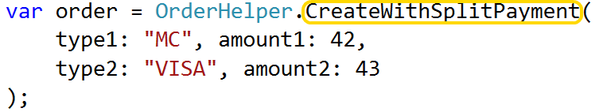
Patterns & Practices – Test Helpers
Can act like an Object Mother, too
Notes:
Generally speaking, helpers have a single method called Create()
Creates as generic an object as possible
Whole point is that caller specifies what it cares about
In some cases, create specialized helpers like an Object Mother
Consider if you notice patterns in your setup code
For instance, same set of parameters being set at same time
This example shows a helper that creates an Order with multiple payment types.
Less code than calling standard Create() method w/ lots of arguments
Easier to refactor related tests
Do this sparingly – same drawbacks as Object Mother
Transition:
After some experimentation, my team has settled on Test Helpers as our go-to pattern
Flexible, easy to implement, and easy to extend for integration tests
We’ll come back to that in a bit

Slide 61
Patterns & Practices – Scenarios
A façade for invoking multiple Test Helpers
Use when objects have relationships you care about
Notes:
Test Helpers are great at returning single object - track of multiple objects AND their relationships?
Example: product review feature - one or more Products, one or more Customers w/ Reviews for those products, etc
Wiring up by hand is tedious & sacrifices expressiveness
CLICK
We’ve created a pattern we call a “Scenario”
Essentially a façade that simplifies the usage of multiple Test Helpers towards a common goal
Provides a convenient way of tracking relationships between test data

Slide 62
Patterns & Practices – Scenarios
A façade for invoking multiple Test Helpers
Most useful when objects have complex relationships
Reuse complex arrangements w/out inheritance
Notes:
Changes are:
If your feature requires complicated setup, you’re going to have multiple tests
If you have multiple tests for the same feature, you’ll probably want to re-use setup code
Specifically designed for reuse
Transition: So what does a Scenario object look like?

Slide 63
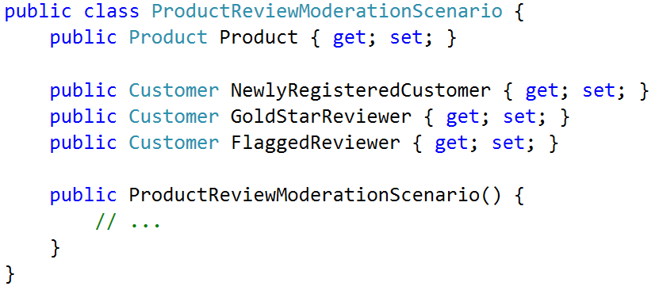
Patterns & Practices – Scenarios
Expose key data as instance properties
Notes:
Biggest difference between Scenario & Test Helper – static factory vs instance
Key objects or relationships are exposed as instance properties of the Scenario

Slide 64
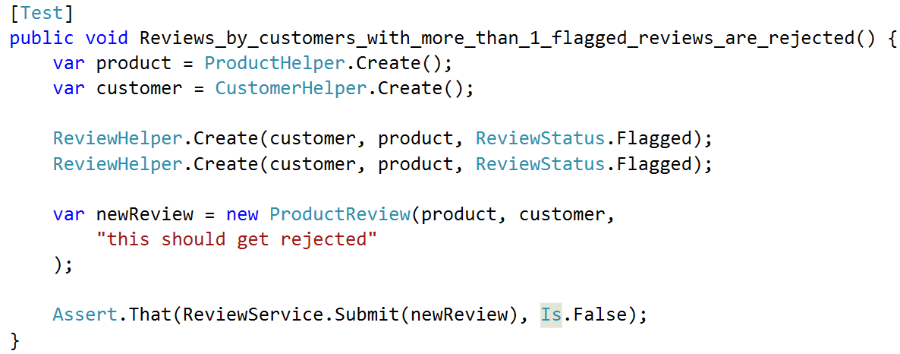
Patterns & Practices – Scenarios
Which is more expressive?
Notes:
Here’s an example of why this is useful.
This test does NOT use a scenario
Asserts that customers cannot submit new reviews once they’ve been flagged for objectionable content
Test creates a product and a customer, then 2 flagged reviews
Finally, tries to submit a new review & asserts it is rejected
Certainly not a terrible test - could be better

Slide 65
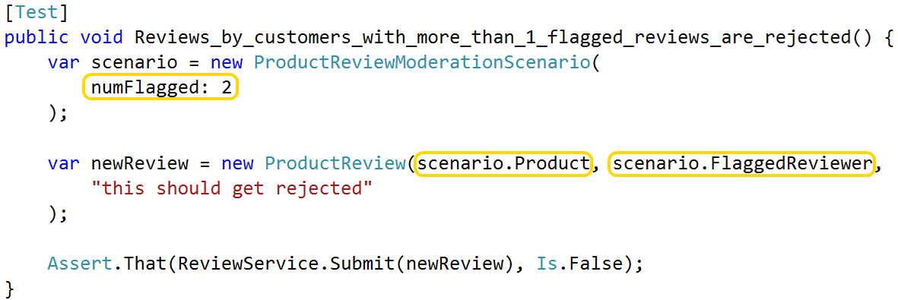
Patterns & Practices – Scenarios
Which is more expressive?
Notes:
Here’s the same test, re-written with a Scenario
Notice that I’m instantiating the scenario object & passing data to the constructor
Notice how much less noisy it is, without the customer and product objects
Scenario exposes references to them
Replaced the explicit creation of two flagged reviews with a single declarative argument
To repeat this test with a different # of flagged reviews, copy 1 line of code & change 1 argument
Excellent example of how expressive setup code makes it easy to add new tests

Slide 66
Patterns & Practices – Scenarios
Same drawbacks as Object Mother
Painful when tests need to customize data
Hard to change once many tests use it
Notes:
Not perfect
Same drawbacks as Object Mother – Scenario is basically a Mother for a group of objects

Slide 67
Patterns & Practices – Scenarios
Same drawbacks as Object Mother
Painful when tests need to customize data
Hard to change once many tests use it
Rarely reusable globally
Scenarios represent tight coupling between data
Use instead of base class
Notes:
Mitigated somewhat by the fact that Scenarios are rarely reusable in any broad terms
By their nature, represent tight coupling between multiple objects
Coupling reduces their ability to be reused in different contexts
I use Scenarios when a group of related tests share complex setup.
I rarely use them in a wider context

Slide 68
Patterns & Practices – object construction
Test Helpers to create single objects
Notes:
Take a second & summarize object creation patterns
Click for Test Helpers
First, avoid constructing test objects by hand
If you need to create a single object, consider Test Helper (or Object Mother or Data Builder)

Slide 69
Patterns & Practices – object construction
Test Helpers to create single objects
Scenarios to create multiple, related objects
Notes:
Use Scenarios if you need multiple objects AND they are related to each other
Scenarios are also a good alternative to inheritance for sharing setup code

Slide 70
Patterns & Practices – object construction
Test Helpers to create single objects
Scenarios to create multiple, related objects
Put these classes in your Test project
Notes:
I recommend that you put these helpers in your Test project.
If you have multiple test projects, consider creating a “Test Library” project so that you can reuse them across the board.

Slide 71
Patterns & Practices – object construction
Test Helpers to create single objects
Scenarios to create multiple, related objects
Put these classes in your Test project
Not free, but worth the investment
Notes:
Creating these helpers DOES have a cost
Adding them to a large legacy project can be especially painful
Been there, done that, worth it
On existing legacy project
Recommend start w/ helpers for smaller objects first
Build up to your larger objects over time
Starting with the most complex object could be a rabbit hole
On greenfield project
Create these as you go, even if it seems like overkill
You’ll be glad you did

Slide 72
Order brought to chaos
Notes:
Here’s that nasty chunk of setup code I showed at the start

Slide 75
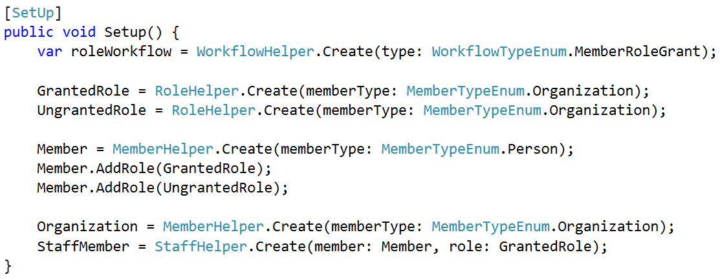
Order brought to chaos
Notes:
Here’s that same chunk of code, cleaned up
Determined many objects were irrelevant – pushed into helpers & used defaults
Still creating a lot of objects, but something that’s manageable
Said it before and I’ll say it again; single most important thing is to build a good helper library

Slide 76

Advanced Techniques – integration tests
Notes:
Until now, in-memory objects only
Eventually, you’re going to want to save your test data to a database so that you can test your data access code, or so that you can automate some of your full-stack system tests.
In this final section, I’ll show you how to use Test Helpers in integration tests

Slide 77
Advanced Techniques – integration tests
Goal: same helpers create data in-memory and in-db
Notes:
It would be really nice if we could use the same Test Helpers to create real data as in-memory data

Slide 78
Advanced Techniques – integration tests
Goal: same helpers create data in-memory and in-db
Challenges:
Foreign keys
Column constraints
Don’t litter database with junk data
Notes:
Easier said than done.
First, you have to deal with foreign keys.
Can’t just new up a Customer and an Order in-memory,
Have to new up entire object graph, save objects to the database in the correct sequence, and then update all the IDs
(This is a little bit easier if you assign primary keys in your application code, but my project uses good old-fashioned autonumber keys)
Second, you have to deal with column constraints.
Non-null columns
Max length
* Lastly, clean up test data when the test run is over.

Slide 79
Advanced Techniques – integration tests
Goal: same helpers create data in-memory and in-db
Challenges:
Foreign keys
Column constraints
Don’t litter database with junk data
Solution: Add a Save() method to Test Helpers
Notes:
These challenges are a pain, but they are manageable with a few extra additions to your Test Helper classes.
The solution we use is to add a Save() method to your Test Helpers
Before I show you how that works, I want to mention a few things
First, this feature assumes you’re using an ORM of some sort. If you’re NOT using an ORM then the concept still applies, but you’ll need to find a different implementation
Second, these code samples are for Nhibernate. You’ll obviously need to modify them to work with Entity Framework or Active Record or whatever you’re using
Let’s look at how the Save method is implemented in my helpers

Slide 80
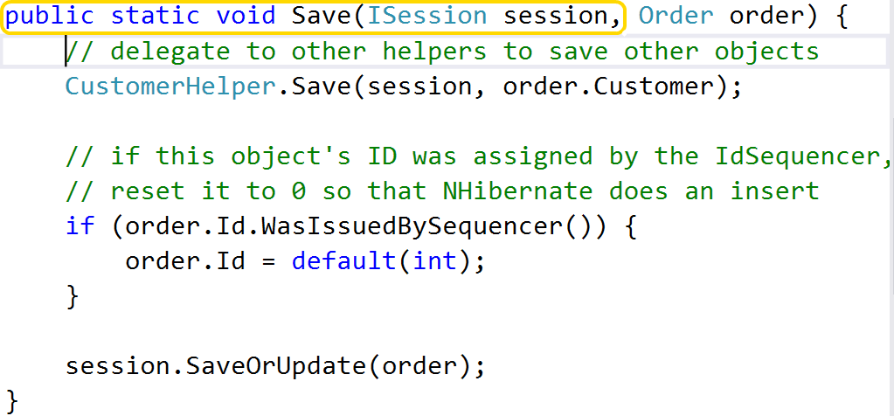
Advanced Techniques – integration tests
Notes:
1st, Save() is static & takes ORM interface as an argument.
It’s certainly possible to use Dependency Injection
All the other helper methods are static – not worth effort for my team

Slide 81
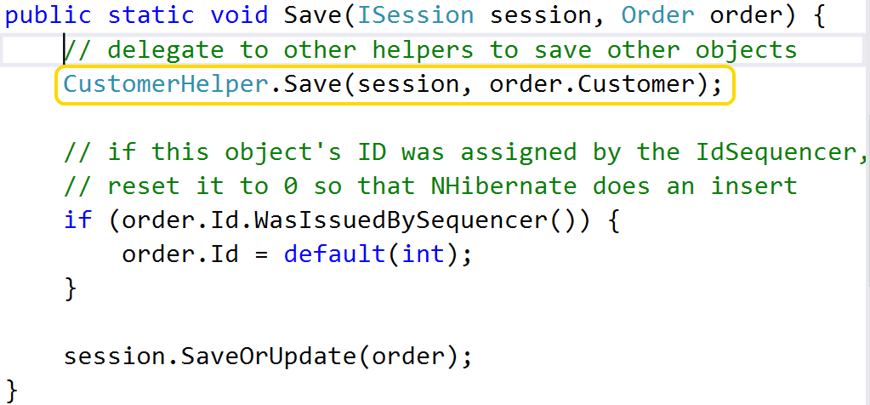
Advanced Techniques – integration tests
Notes:
Next, note that we delegate to other helpers to save any of our dependent objects
Can’t save an Order unless it refers to a valid customer – save the Customer first
Remember, each Test Helper deals w/ one object type only

Slide 82
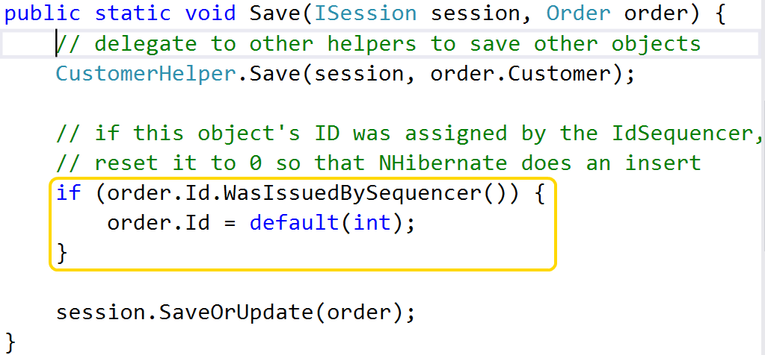
Advanced Techniques – integration tests
Notes:
Third, Save method is responsible for resetting any Id values that were assigned by the IdSequencer to 0
We’re using Nhibernate in this example, and if we tell it to save an object that has a non-zero ID, it will issue an update
Resetting the Id to zero forces it to do an insert, which is what we want
Note that we don’t need to reset ALL values that were assigned by the IdSequencer, only entity IDs

Slide 83
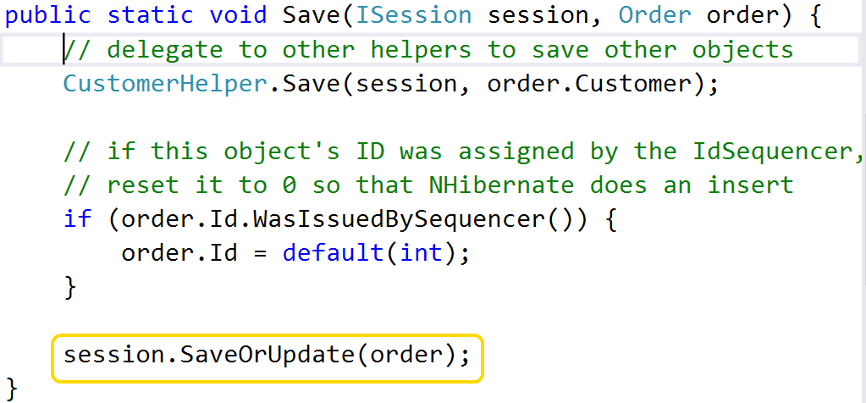
Advanced Techniques – integration tests
Notes:
Finally, we delegate to the ORM to insert or update the object
Each helper should know how to save the objects that it creates
The implementation of your Save methods will be driven by your Create methods –
Does NOT need to handle any arbitrary object, only those configurations created by the helper
Transition
Finally, we need to prevent this test data from lingering around when our test run is over
One possibility is to reset the database to a known state at the start of each test run. This works, but I tend to run my unit tests against the same DB I use for local testing
Don’t want data I’ve crafted by hand from being blown away by tests
Don’t want to lose any schema changes I’ve made

Slide 84
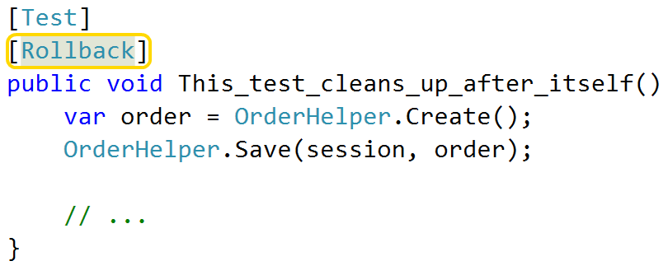
Advanced Techniques – integration tests
[Rollback] attribute
Creates DB transaction when test starts
Rolls back when test ends
Notes:
Another option is to wrap each test run in a database transaction, and then roll back that transaction when the test run is over
This is easy to do by adding an attribute to our data tests. The presence of this attribute automatically executes the test inside of a transaction, and then discards the transaction at the end.

Slide 85
A quick recap…
Good setup code:
Is highly expressive
Highlights what matters / downplays what doesn’t
Doesn’t use inheritance
Is resilient
Notes:
Let’s recap
Good setup code:
Is highly expressive
Highlights what really matters
Avoids inheritance for shared data
Does not require a lot of upkeep

Slide 86
A quick recap…
Good setup code:
Is highly expressive
Highlights what matters / downplays what doesn’t
Doesn’t use inheritance
Is resilient
How?
Short, clean code
Use helpers for object creation
Notes:
And how do we achieve these goals?
Short, clean code
Use helpers for object creation

Slide 87
Parting Words of Wisdom
Hard to test == too complex. Simplify!
Liked what you saw today?
Download materials from github.com/spetryjohnson
Read my blog at petry-johnson.com
Questions / Comments / Suggestions / Flames?
@spetryjohnson
seth@petry-johnson.com
Notes:
I’d like to wrap up with last piece of advice:
CLICK
If something is hard to test, it’s probably too complex.
Don’t be “clever” in your tests – change design to make cleverness unnecessary.
Clean, simple, elegant are the keys to success
CLICK: You can download these materials from my Github account
CLICK: If you have any questions or feedback of any sort, reach me on Twitter or email.
THANK YOU!

